Slide 1

PYTHON FOR DATA SCIENCE
Necessary Skills
To
Step into AI world

Slide 2
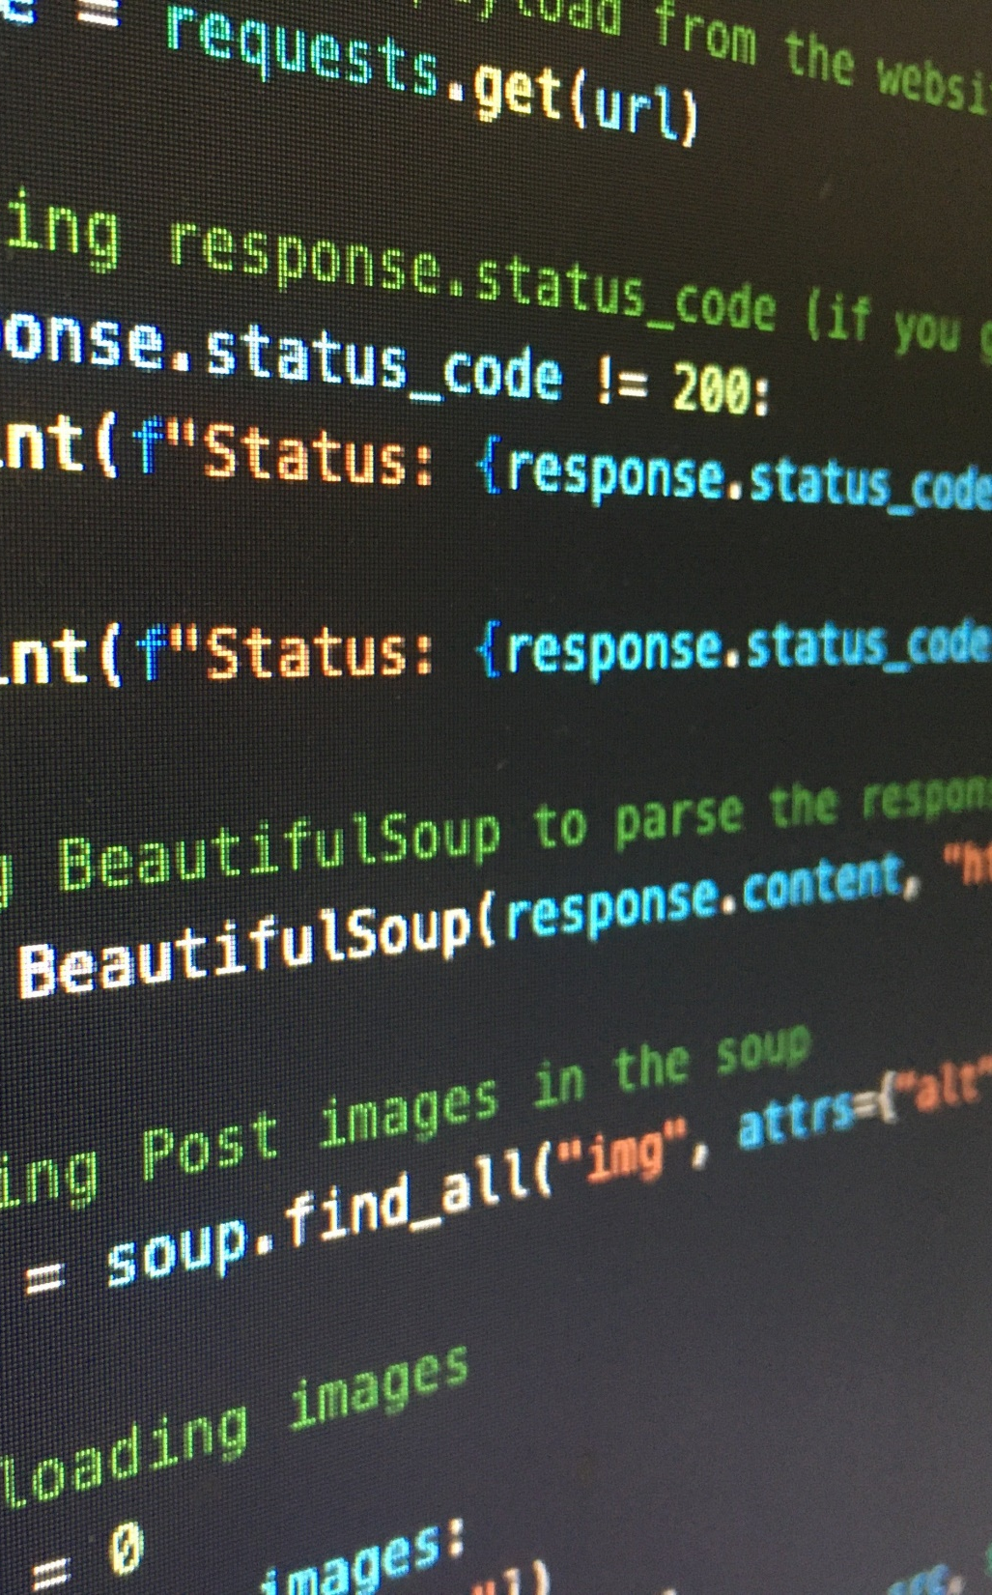
Working with databases – p1
Introduction to Databases
Database Concepts
Keys
Introduction to SQlite
CRUD on SQlite
Introducing ‘Cursor’

Slide 3
Working with databases – p2
Tools of the Trade in Big Databases
Configuring MySQL
Connection Error Handling
CRUD in MySQL

Slide 4
Introducing API concepts – p1
Introduction to API
Discussing Rest-API
API Call
Getting to Know JSON Format
Working with Restful APIs
Project: Getting Data From ‘NASA’ Mars Rover

Slide 5
Introducing API concepts – p2
Concepts of fastAPI
Writing Your First API
Path Parameters
Enumerations
Query Parameters

Slide 6
Crawling
What Are Crawlers?
Selenium
Quick Overview on CSS Styling
Quick Overview on HTML Tags
Extracting the Exact Information From Websites
Project: Crawling Digikala

Slide 7
Introducing numpy
Jupyter Notebook
Introducing Numpy
Creating a Numpy Array
Numpy Array vs List
Calculating Norm and Inner Product
Matrices in Numpy
Solving Linear Systems in Numpy

Slide 8
Introducing matplotlib
Getting to Know Charts
Histograms
Piechart
Boxplot
Errorbar

Slide 9
Introducing pandas
Reading Files Into Pandas
Matrix Manipulation in Pandas
Introducing Data Frames
Working With Rows and Columns

Slide 10
Introducing Scikit-learn
Data Cleaning
Data Encoding
Re-scaling Data
Introducing Outliers
Outlier Detection
Project: Avocado Price Estimation

Slide 11
Scipy
Quick Intro to Scipy

Slide 12
Final Project
Dataset Introduction
Data Pre-processing Modules
KNN Estimator
Confusion Matrix of KNN Results
Creating CNN Model
CNN Results

Slide 13
bonus
Getting to Know Streamlit
Creating Web Based UI
Backend Handling
Model Serialisation
Sending Requests to Server
Updating UI Based on Server Response

Slide 14

NOTES
WEBSITES
Prerequisites
www.python.org
https://scikit-learn.org/stable
https://numpy.org/
Python Fundamentals
TEXTS
Depends on Instructor
Suggested Time
30 Hours

Slide 15

Document History
Author | Version | Revision | Date / Time | Department | Validity
Mehdi Shokri | 1.0.0 |  | 14-05-2023 | AI | 3 Months
Mehdi Shokri |  | 1.0.1 | 16-05-2023 | AI | 3 Months

